Slide 1

THE ENCHANTED LIBRARY

Slide 2
MEMBERS OF PROJECT:
KASHISH SOARTHIYA (LEADER) : HANDLED FRONTEND
HONEY PATEL : HANDLED BACKEND
BHUMI VYAS : HANDLED BACKEND
SHENAL PARMAR : HANDLED DATABASE
CHOSEN PROGRAMMING LANGUAGES :
BACKEND : PYTHON
FRONTEND : CUSTOM TKINTER (PYTHON’S FRAMEWORK)
DATABASE : MYSQL
INSTRUCTOR : PROFESSOR SOURISH DAS GUPTA

Slide 3
🏰 Project Theme Overview – The Enchanted Library
The Enchanted Library is set in a magical realm where knowledge is power, and ancient tomes possess secrets from centuries past. This library is not just a place to borrow books—it's a hub of wisdom, history, and mystical resources. Scholars, librarians, and guardians must work together to protect, restore, and manage the collection of rare, ancient, and restricted books.
To maintain the delicate balance of access and security:
Only certain roles (like scholars or librarians) can borrow or reserve sensitive materials like Ancient Scripts or Rare Books.
Guests can explore general books, but cannot access the deeper magical content.
Fine calculations and restoration needs are handled magically and securely to ensure the system is just and fair.
This project simulates real-world library challenges (like book availability, role-based access, overdue fines, etc.) in a fantasy-like narrative environment, blending technology with imagination to create a secure, intelligent, and user-friendly book management system.

Slide 4
⚠️ Key Issues in the Existing System
Manual Book Management Tracking book availability, condition, and borrowing history manually leads to errors and inefficiency.
No Role-Based Access All users have equal access, which risks exposure to rare or restricted materials that should be limited to scholars or staff.
No Real-Time Updates Delays in updating book status (borrowed, returned, reserved) cause confusion and double bookings.
Fine Calculation Challenges Manual fine tracking is inconsistent and lacks proper documentation of due dates or late returns.
Lack of Notifications Users are not informed about due dates, return reminders, or system updates, reducing user engagement and compliance.
Security & Data Integrity Risks Without a proper database and authentication system, data loss or unauthorized access is a serious concern.
No Digital Reservation System Users cannot reserve books in advance or check availability from remote locations.

Slide 5
🎯 Objectives of the Redesigned Enchanted Library System
Digitize Book Management Automate the process of adding, tracking, reserving, borrowing, and returning books using a secure database.
Implement Role-Based Access Control Define and restrict actions based on user roles (Admin, Librarian, Scholar, Guest) to ensure appropriate access.
Enable Real-Time Updates Reflect book status changes (Available, Reserved, Borrowed, RestorationNeeded) instantly within the system.
Automate Fine Calculation Introduce dynamic fine computation based on user roles and return delays, improving fairness and accuracy.
Provide Smart Notifications Alert users about reservations, due dates, returns, and fines through a built-in notification center.
Ensure System Security & Reliability Use authentication, data validation, and a structured MySQL database to maintain data integrity and security.
Enhance User Experience with GUI Design a user-friendly Custom Tkinter-based interface for seamless interaction and navigation.
Support Book Type Restrictions Prevent certain users (e.g., guests) from accessing rare or ancient books based on defined book types.

Slide 6
📦 Main Classes and Relationships
1. LoginPage
Handles user login input and validation.
On successful login → initializes LibraryDashboard.
🔁 One-to-One with LibraryDashboard (only one dashboard per login).
2. LibraryDashboard
Central hub after login, displays:
Dashboard
Book view
Reserve, Borrow, Return actions
Notifications
Role-based functionality (admin, scholar, librarian, guest).
🚪 Interacts with all feature modules (borrow, reserve, return, notifications).
3. FineCalculator
Used in return_book_action().

Slide 7
Calculates fines based on:
Role (admin/scholar/librarian/guest)
Delay in days
🔁 Called only during return.
4. FineSummary
Generates a summary dialog after fine calculation.
Summarizes:
Book name
Due date
Return date
Days late
Fine amount
🔗 Relationships
LoginPage → launches → LibraryDashboard
LibraryDashboard → uses → FineCalculator and FineSummary
LibraryDashboard ↔ interacts with MySQL (users, books, borrow_records, reservations, notifications tables)

Slide 8
OOP CONCEPTS USED IN ENCHANTED LIBRARY
✅ Encapsulation
Each class (like User, Book, BorrowRecord) contains private or protected attributes.
Access and updates to data (like book status or user roles) are controlled via methods, preventing
unauthorized or accidental changes.
Example: Methods like borrow_action() and return_book_action() manage state changes securely.
✅ Inheritance
A base class like User can have subclasses like Admin, Librarian, Scholar, and Guest.
Common functionality (like login or notification access) is inherited, while specific privileges (e.g., access
to rare books) are extended in subclasses.
✅ Polymorphism
Methods like borrow() or return() may behave differently depending on the user role (e.g., Guest vs
Librarian).
Dynamic behavior allows reusing method names while customizing outcomes—like borrowing limits or
allowed book types.
✅ Abstraction
UI buttons and event handlers call abstracted logic (e.g., borrow_action()), hiding complex database
operations.
Users interact with a simple interface, while details like SQL queries and validations are handled
behind the scenes.

Slide 9
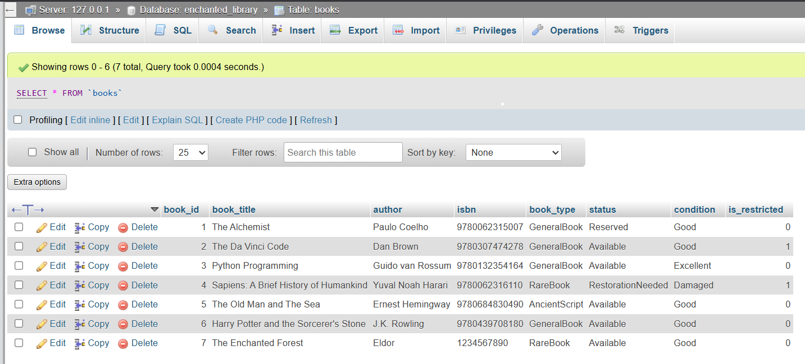
TABLE : BOOKS

Slide 10
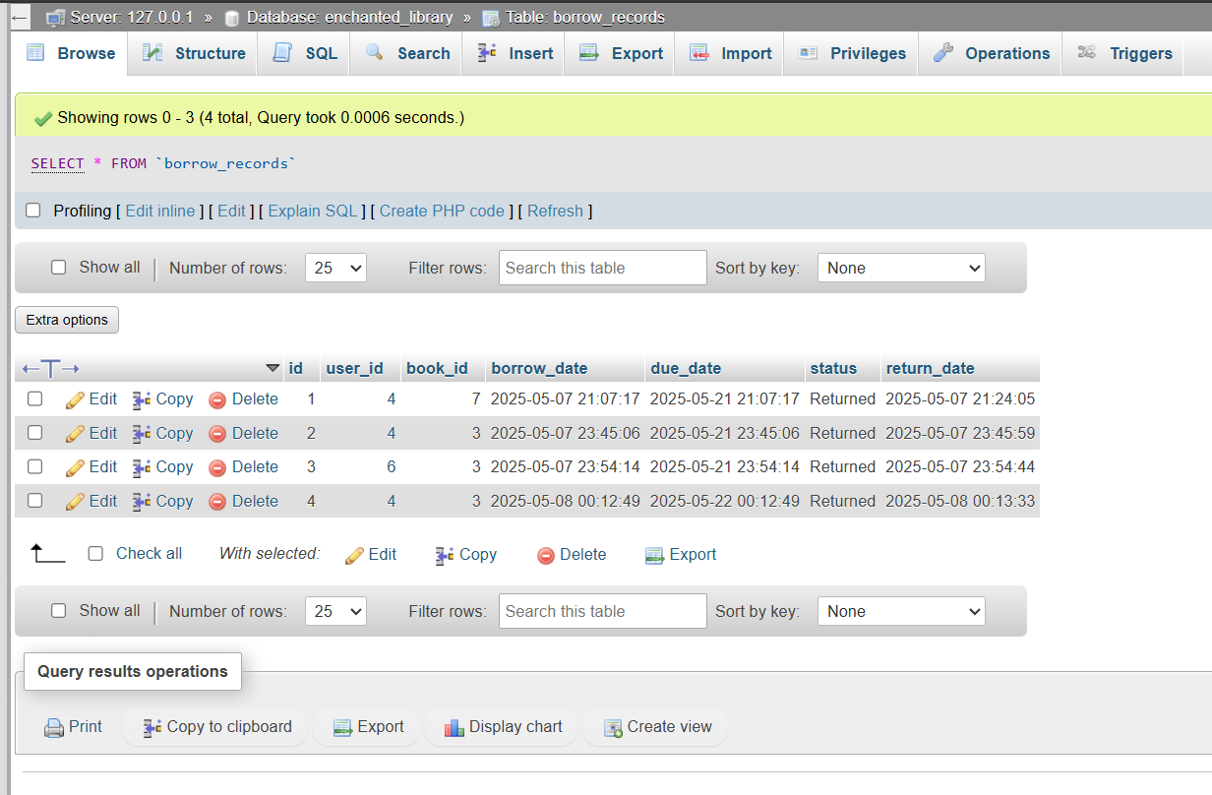
TABLE : BORROW RECORDS

Slide 11
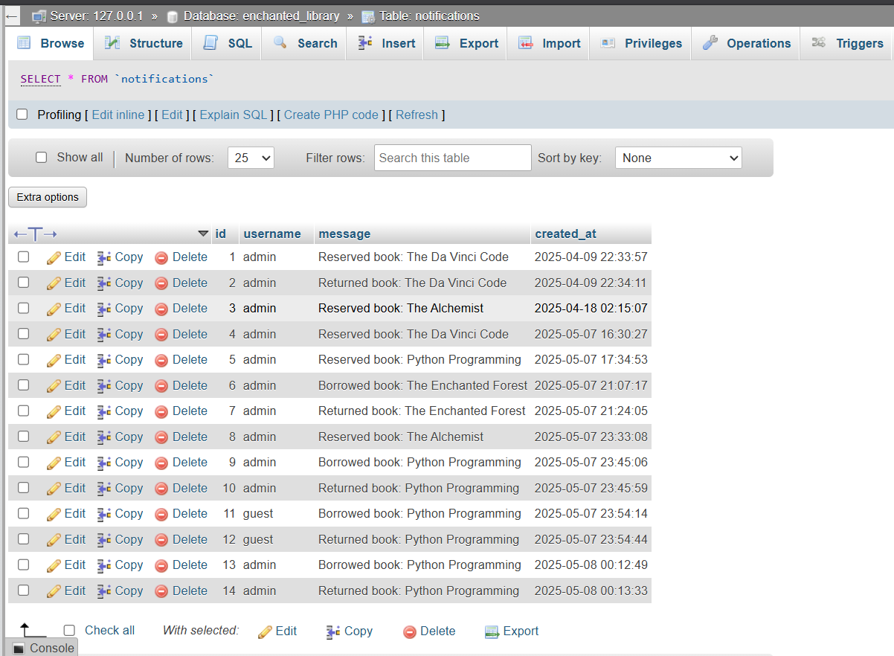
TABLE : NOTIFICATIONS

Slide 12
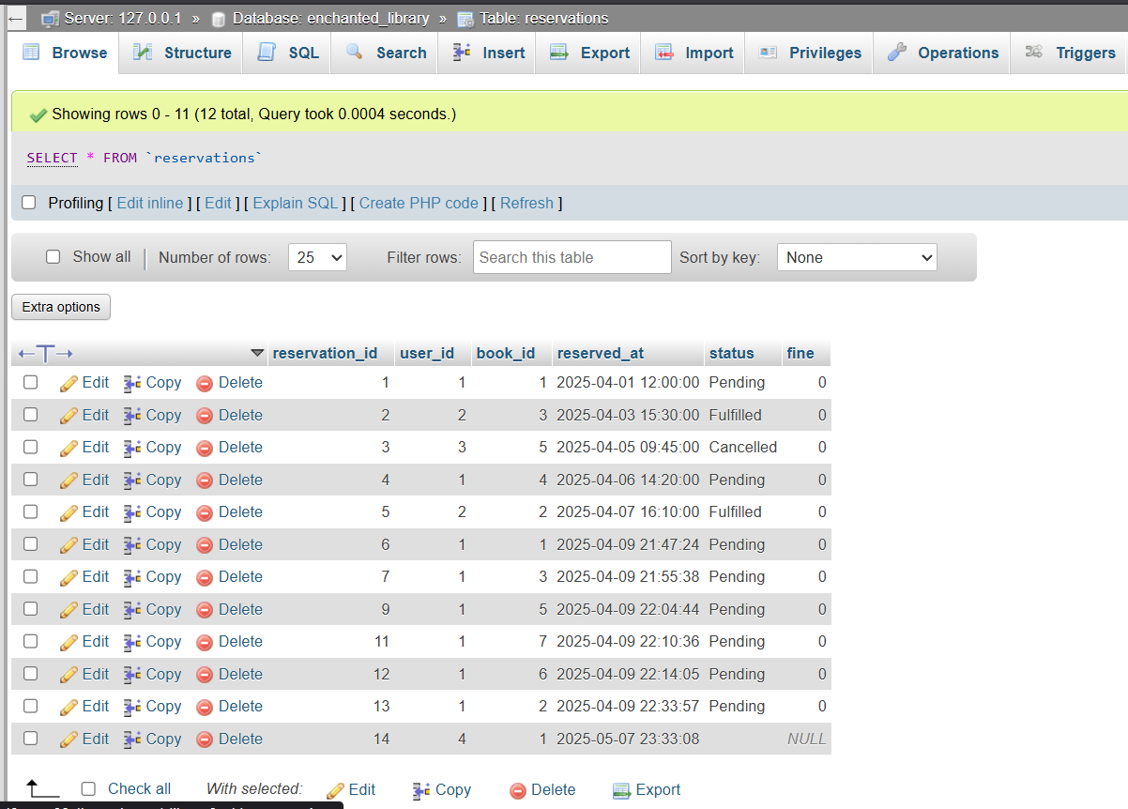
TABLE : RESERVATIONS

Slide 13
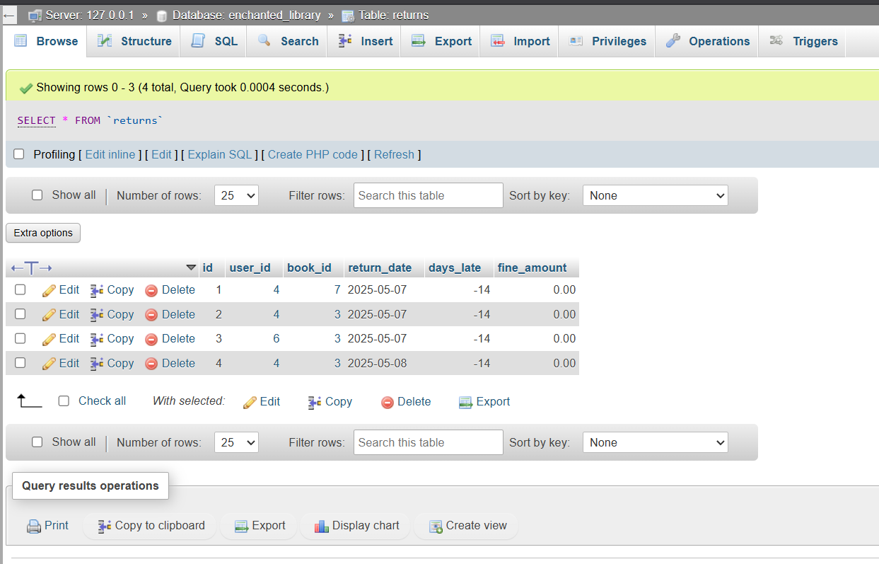
TABLE : RETURNS

Slide 14
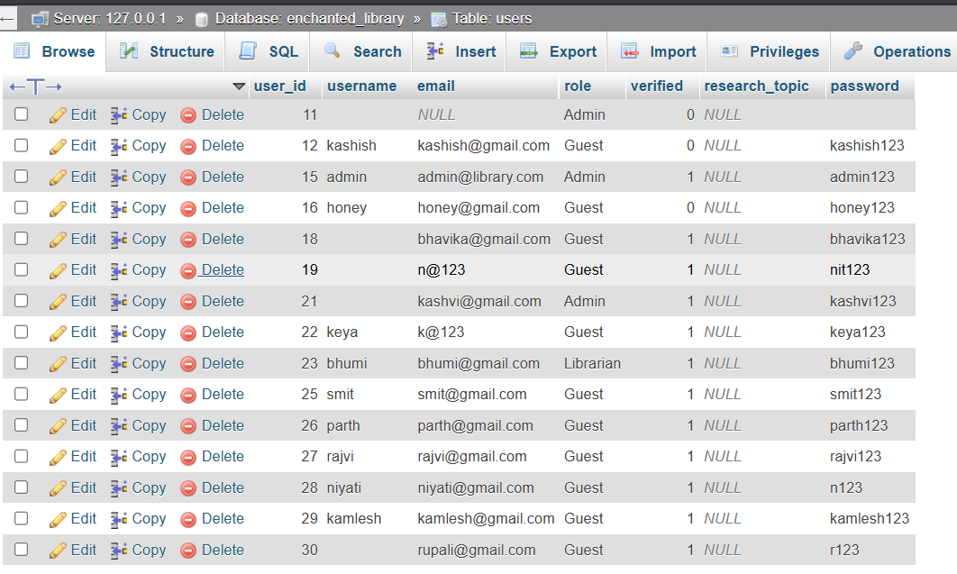
TABLE : USERS

Slide 15
🏗 1. Creational Patterns
Factory Pattern
Usage: To create user objects dynamically based on login role.
Example:
def create_user(role, user_data):
if role == "admin":
return Admin(user_data)
elif role == "librarian“
: return Librarian(user_data)
elif role == "scholar":
return Scholar(user_data)
else:
return Guest(user_data)
This abstracts the object creation logic away from the main flow.

Slide 16
Singleton Pattern
Usage: To maintain a single database connection pool or central notification system.
Example:
class DBConnection:
_instance = None
def __new__(cls):
if cls._instance is None:
cls._instance = super().__new__(cls)
# setup DB connection
return cls._instance

Slide 17
🧱 2. Structural Patterns
Facade Pattern
Usage: Simplifies complex UI interactions behind a single interface.
Example: Instead of calling separate methods for book lookup, availability, role check,
and update — borrow_action() handles it all internally and exposes a clean method to the GUI.

Slide 18
🔄 3. Behavioral Patterns
Observer Pattern
Usage: For the notification system — users are notified when actions like borrow, reserve, return
happen.
Example:
class NotificationManager:
def notify(self, user, message):
# Insert into notifications table
Strategy Pattern
Usage: For late fine calculation — varies based on role (e.g., guests might have stricter fines).
Example:
class FineCalculator:
def __init__(self, strategy):
self.strategy = strategy
def calculate(self, days_late):
return self.strategy.calculate(days_late)

Slide 19
With role-specific strategies:
class GuestFineStrategy:
def calculate(self, days):
return days * 10 class ScholarFineStrategy:
def calculate(self, days): return days * 5

Slide 20
✅ Core Features Implemented
🔐 Role-Based Access Control
Users (Admin, Scholar, Librarian, Guest) have different permissions.
For example:
Guests can only borrow general books.
Librarians have full access to manage all books.
Scholars can access both rare and general books.
📚 Book Management System
Features include: Reserve, Borrow, Return with fine tracking.
Real-time updates to book status in the database.
📦 Secure Transaction System
All actions like borrowing or returning books are recorded with timestamps in the borrow_records table.
📆 Fine Calculation Logic
Late return fines are automatically calculated based on days overdue and user role.
Uses Strategy Pattern for flexibility in fine rules.

Slide 21
🎁 Bonus Features
🔴 Real-Time Alerts
Instant feedback through messagebox and the notification panel.
Shows action history like “Borrowed Book: X” or “Returned Book: Y”.
📈 Smart Recommendations
Based on borrowing history (e.g., recommends books from the same genre or author).
📋 Admin Analytics Panel
Could show total books borrowed, overdue stats, or user activity logs.

Slide 22
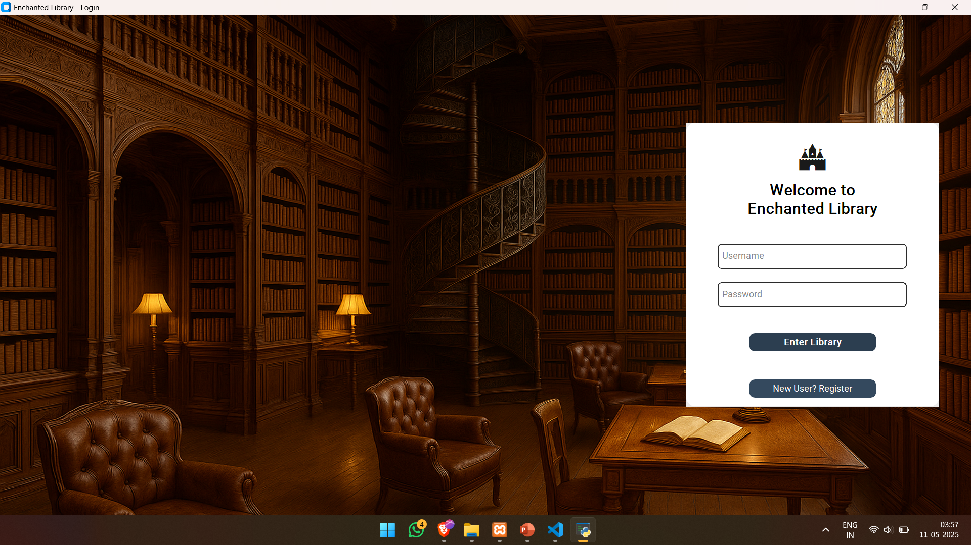

Slide 23
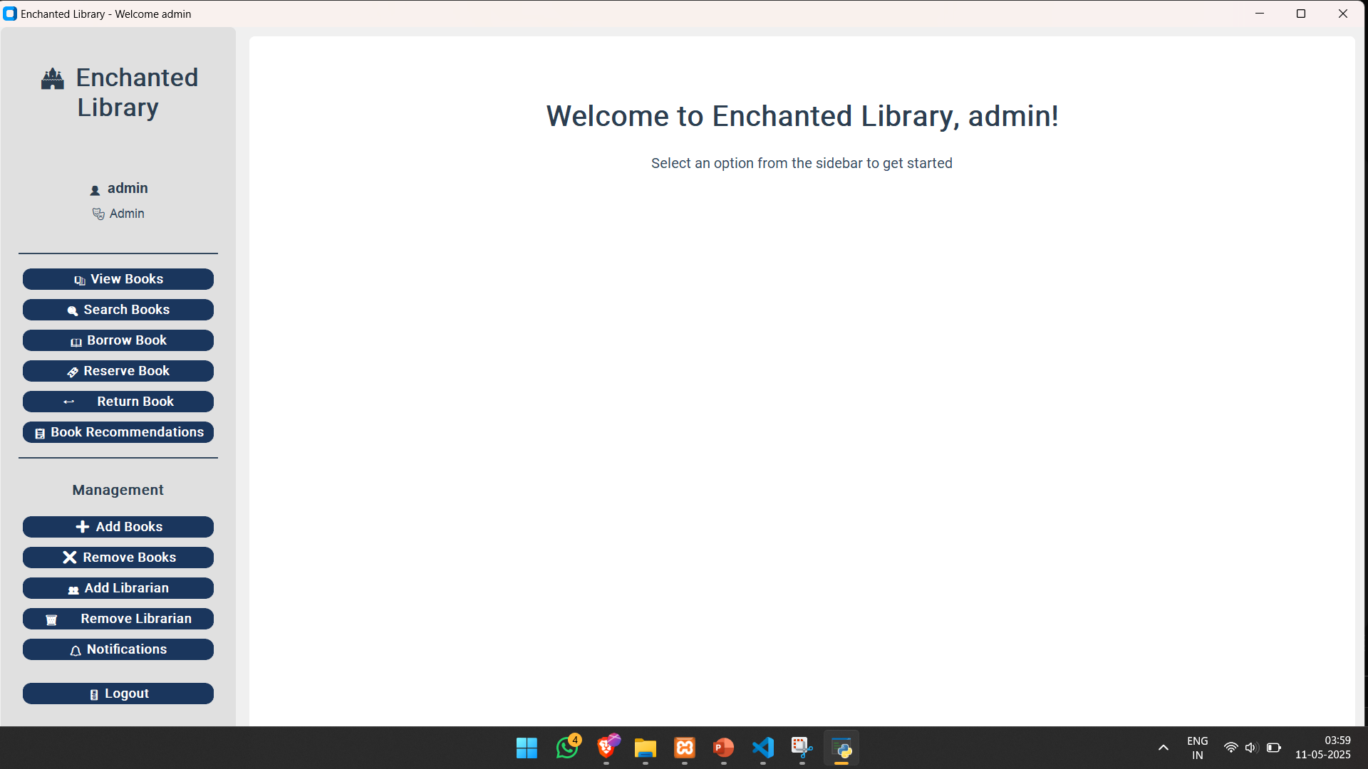

Slide 24
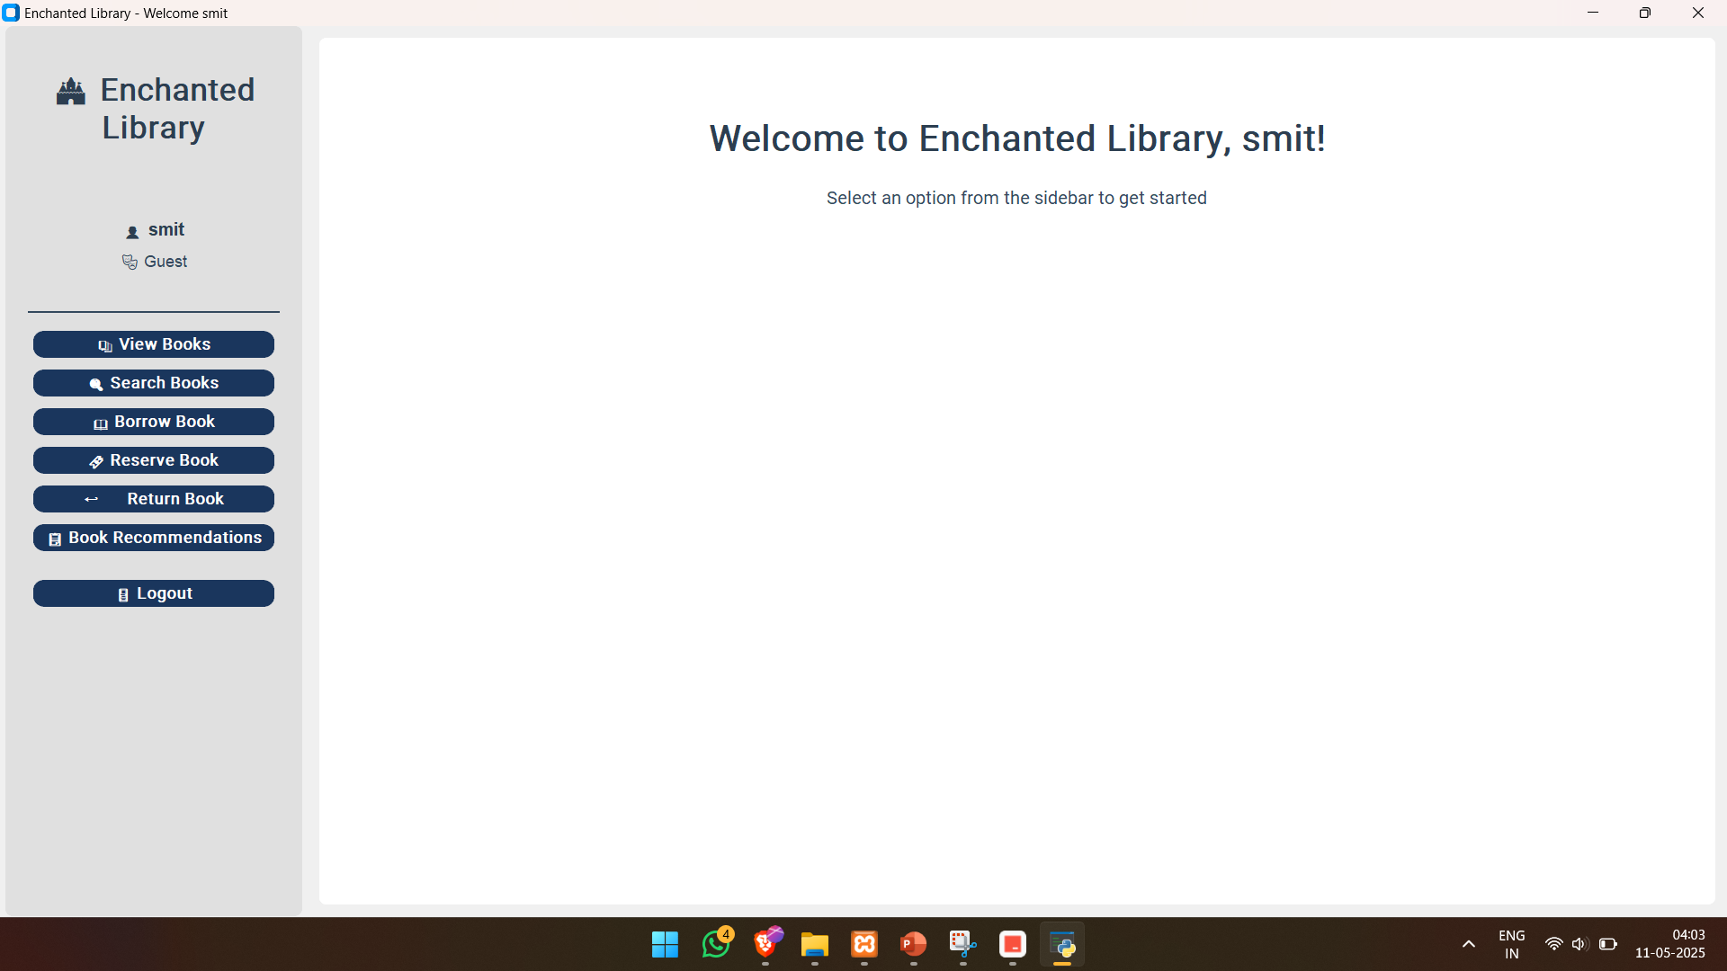

Slide 25
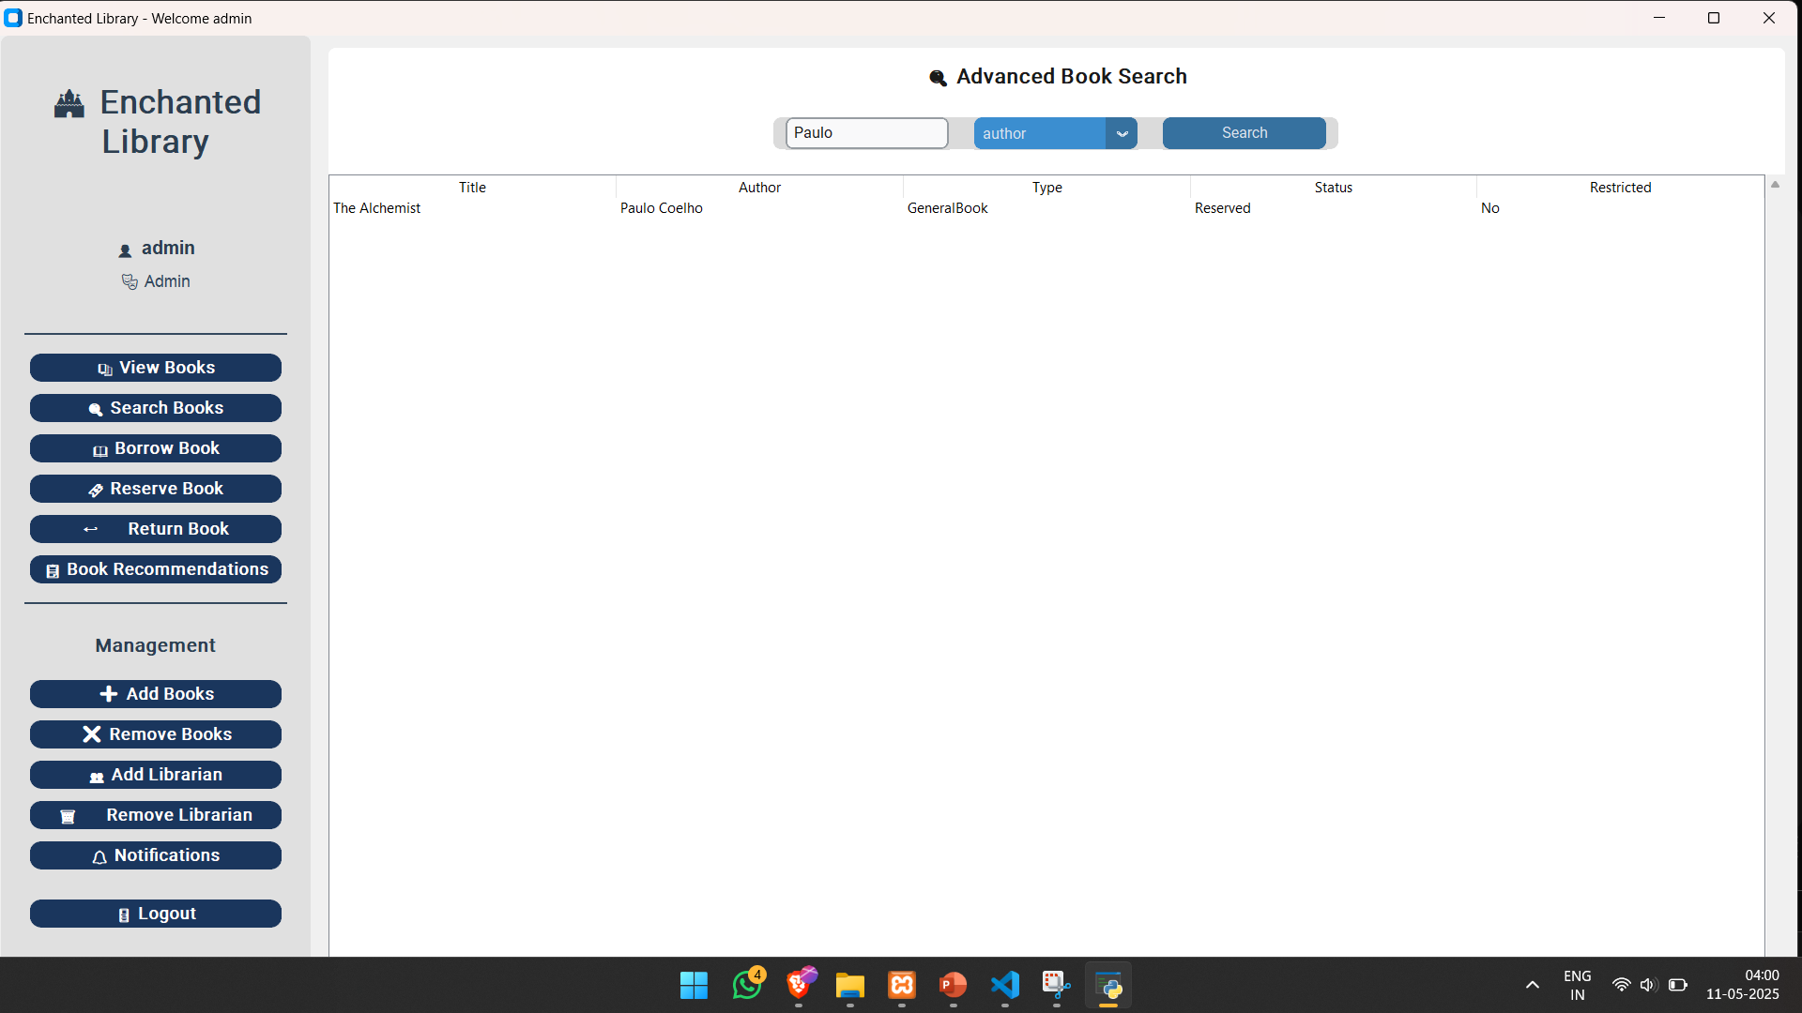

Slide 26
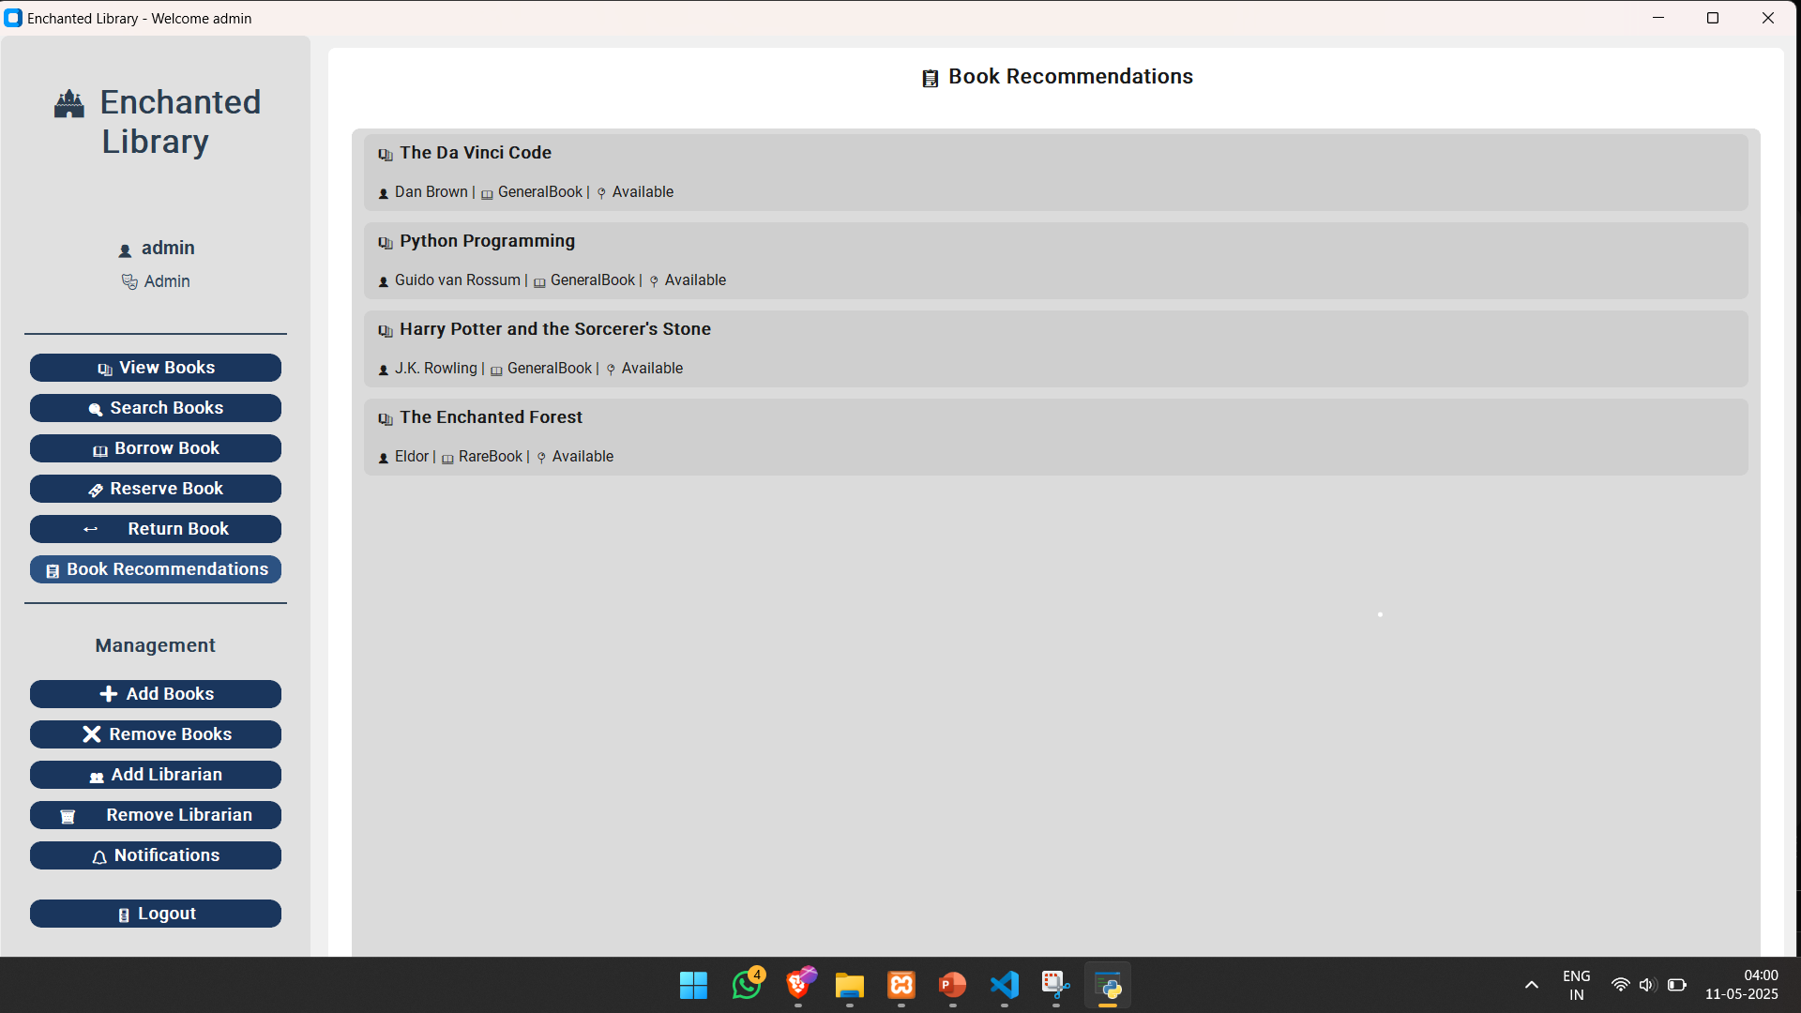

Slide 27
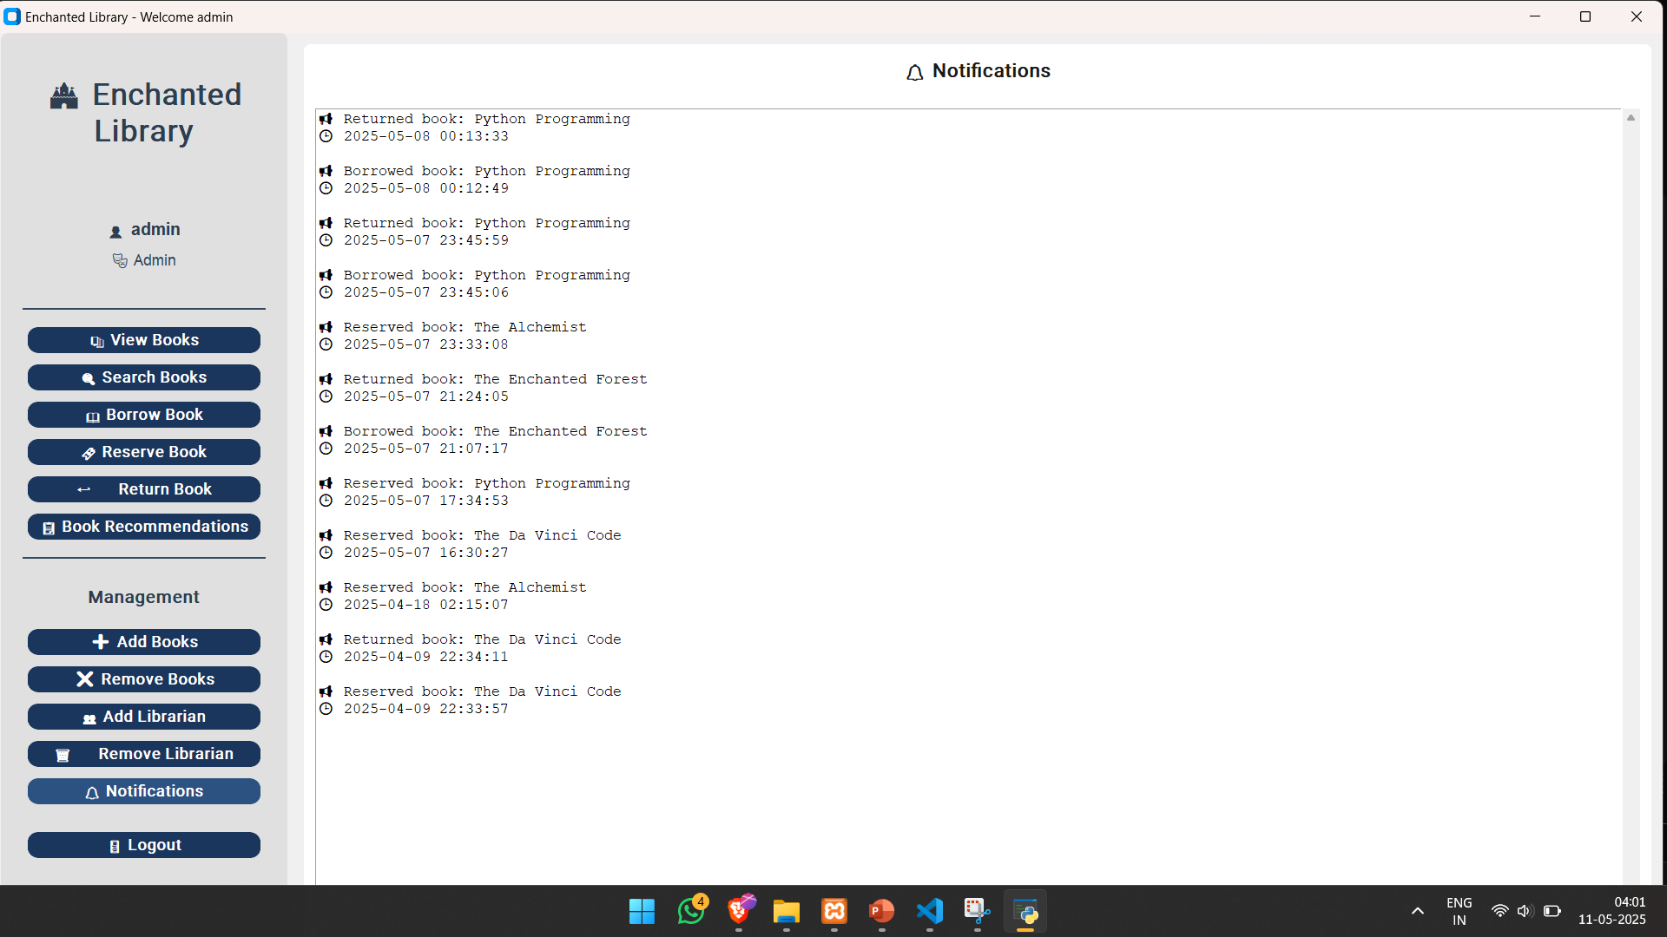

Slide 28
⚙️ Technical & Team Challenges
🔧 GUI Integration Errors: Initial CustomTkinter elements had click/update issues; required multiple debugging cycles.
🧱 Database Sync: Ensuring MySQL fields (e.g., book_title vs title) matched backend queries exactly.
🧪 Late Fine Logic: Balancing fine calculation across roles and ensuring return records update properly.
👥 Coordination: Aligning individual contributions into a single, clean working version took frequent syncing.
📚 What We Learned
🧠 OOP Concepts: Applied real-world abstraction, polymorphism, and inheritance in Python effectively.
🔄 Design Patterns: Understood practical use of Observer, Strategy, Facade in a live system.
🛠 Tools: Gained strong hands-on experience with:
CustomTkinter for GUI
MySQL / phpMyAdmin for backend
GitHub & version control during collaboration
🤝 Teamwork: Learned how to divide roles, troubleshoot merge conflicts, and maintain consistency across modules.

Slide 29
🚀 Future Improvements
🔑 Real-Time User Login System:
Add secure registration and encrypted authentication.
📊 Analytics Dashboard for Admin:
Track usage stats, overdue trends, book demand, etc.
📱 Mobile Responsiveness:
Convert to a responsive web app using Flask or Django + React.
📚 Recommendation Engine:
Use borrowing history and ML to offer smarter book suggestions.

Slide 30
THANK YOU!!!!

